Slide 1
Wildlife Conservation
A Realistic Perspective on Global Biodiversity

Slide 2
The State of Nature
Understanding the Baseline
Not understanding base line
What if I don’t want to understand base line

Slide 3
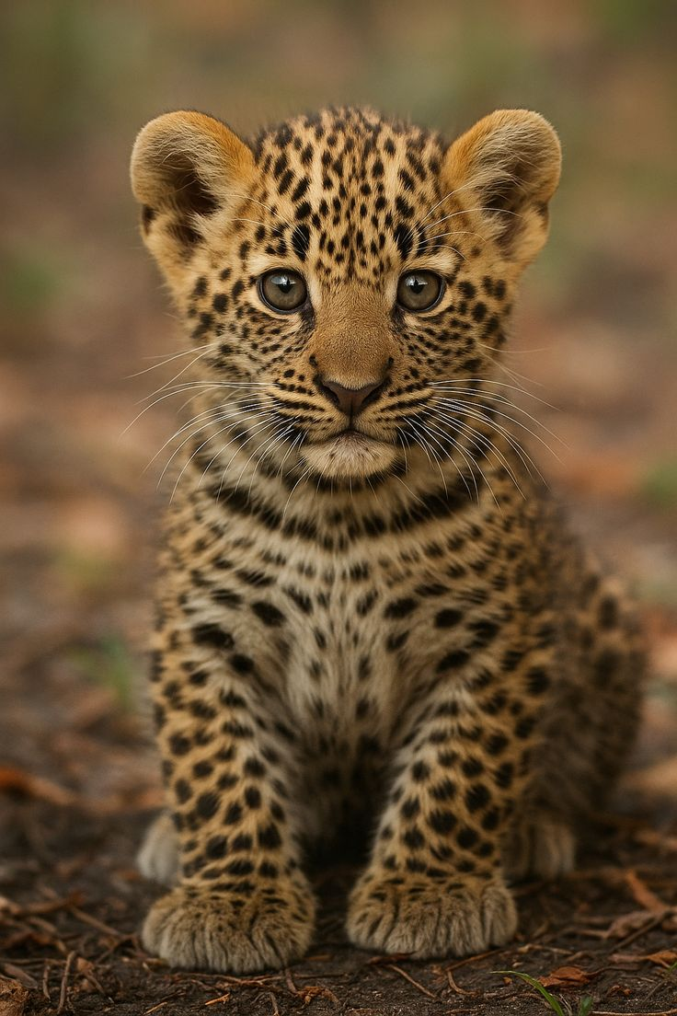
Field Recording

Slide 4

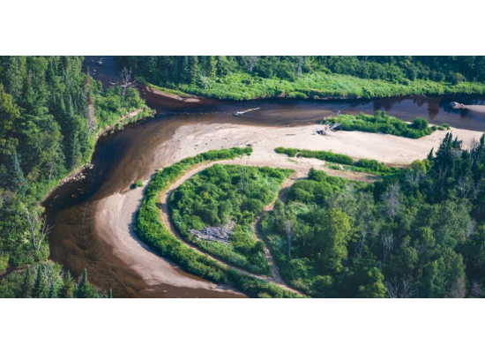
What is Conservation?
Wildlife conservation is the practice of protecting plant and animal species and their habitats. As part of the world's ecosystems, wildlife provides balance and stability to nature's processes.
Ecological Balance: Ensuring food webs remain intact.
Genetic Diversity: Maintaining the resilience of species to disease.
Sustainability: Managing resources for future generations.

Slide 5
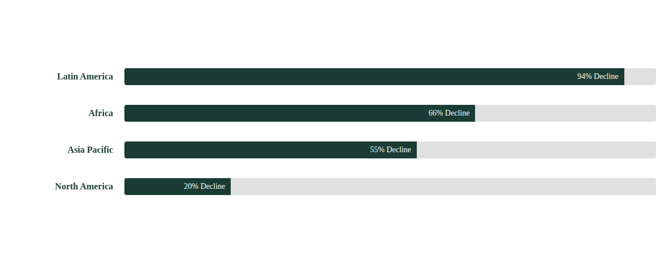
Global Wildlife Population Decline
According to recent indices, average wildlife populations have seen a catastrophic drop since 1970.
The Living Planet Index reports an average 69% decline in monitored wildlife populations between 1970 and 2018.

Slide 6
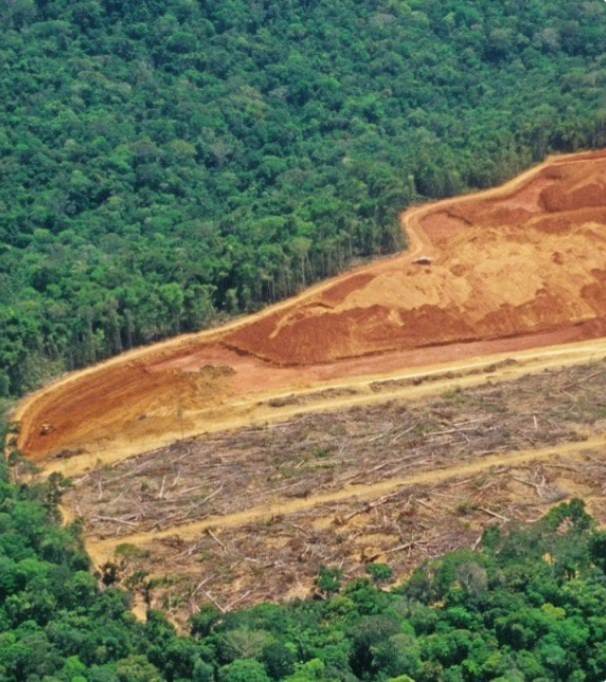
Threat 1: Habitat Loss
The single greatest threat to biodiversity is the destruction, fragmentation, and degradation of habitats.
Agriculture, urban development, and logging strip animals of the resources they need to survive, leading to local extinctions and isolating populations.

Slide 7

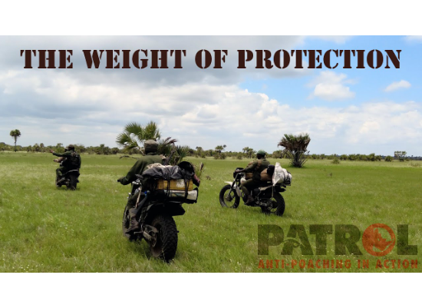

Threat 2: Illegal Wildlife Trade
The illegal wildlife trade is a multi-billion dollar criminal industry. It is not just about elephants and rhinos; it affects birds, reptiles, and plants.
$20 Billion
Estimated annual value of the illegal wildlife trade, ranking it alongside narcotics and human trafficking.

Slide 8
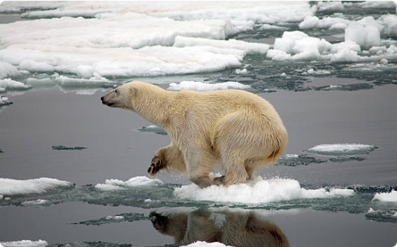
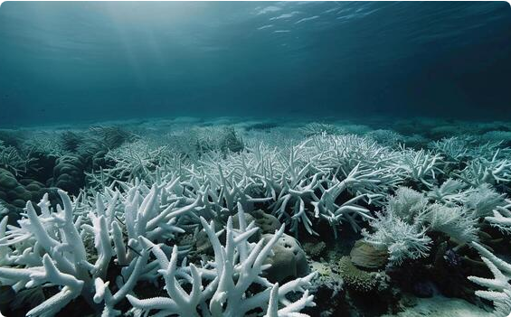
Threat 3: The Climate Crisis
Climate change forces species to migrate, alters breeding cycles, and destroys sensitive ecosystems faster than species can adapt.
Habitat Loss: Melting Sea Ice
Ocean Warming: Coral Bleaching

Slide 9
Threat 4: Invasive Species
Invasive species are non-native organisms that cause harm to the environment, economy, or human health. They often outcompete native wildlife for resources.
Cane Toads: Decimating predators in Australia due to toxicity.
Brown Tree Snake: Caused the extinction of most native forest birds on Guam.
Impact: Responsible for 42% of threatened or endangered species declines.

Slide 10
Strategic Interventions
Science-Based Solutions

Slide 11
Approaches: In-Situ vs. Ex-Situ
Feature | In-Situ (On-site) | Ex-Situ (Off-site)
Definition | Protecting species in their natural habitat. | Protecting species outside natural habitats.
Examples | National Parks, Wildlife Sanctuaries, Marine Reserves. | Zoos, Botanical Gardens, Seed Banks, Aquariums.
Primary Goal | Maintain ecosystem function and evolution. | Insurance population, education, breeding.
Cost | Generally lower per species, high land requirement. | High maintenance cost per individual.

Slide 12
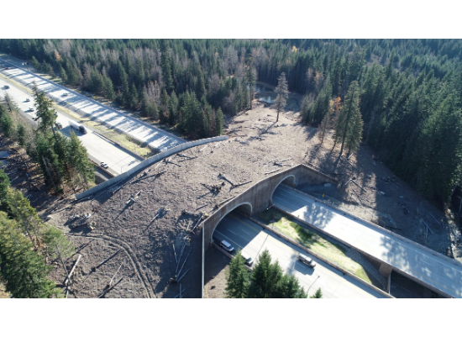
Connectivity & Wildlife Corridors
Habitat fragmentation isolates populations, leading to inbreeding and higher extinction risk. Corridors reconnect these islands of nature.
Benefits:
Safe migration routes.
Increased genetic flow between populations.
Reduced wildlife-vehicle collisions.

Slide 13






Technology in the Field
Drones
AI & Traps
GIS & Tracking
Used for anti-poaching surveillance and monitoring deforestation in hard-to-reach areas.
Camera traps equipped with AI can instantly identify species and alert rangers to poachers.
Satellite collars and GIS mapping help scientists understand migration patterns and habitat use.

Slide 14
Community-Based Conservation
"Conservation will only succeed if it supports the livelihoods of the people who live alongside wildlife."
— Conservation Principle

Slide 15
Legal Frameworks
Strong laws are the backbone of conservation efforts, regulating trade and protecting critical habitats.
CITES: Convention on International Trade in Endangered Species. Regulates cross-border trade of over 38,000 species.
IUCN Red List: The global standard for assessing the extinction risk of species, guiding policy decisions.
National Laws: Examples include the U.S. Endangered Species Act and India's Wildlife Protection Act.

Slide 16
Real-World Case Studies
Successes and Ongoing Struggles

Slide 17

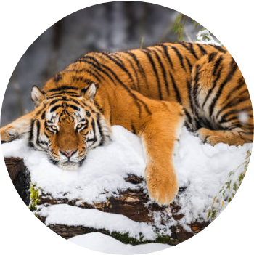
Recovery: The Amur Tiger
Once driven to the brink of extinction in the 1940s (with only ~40 individuals left), strict anti-poaching measures and habitat protection in Russia and China have sparked a comeback.
40
540+
1940s Pop.
Current Pop.

Slide 18
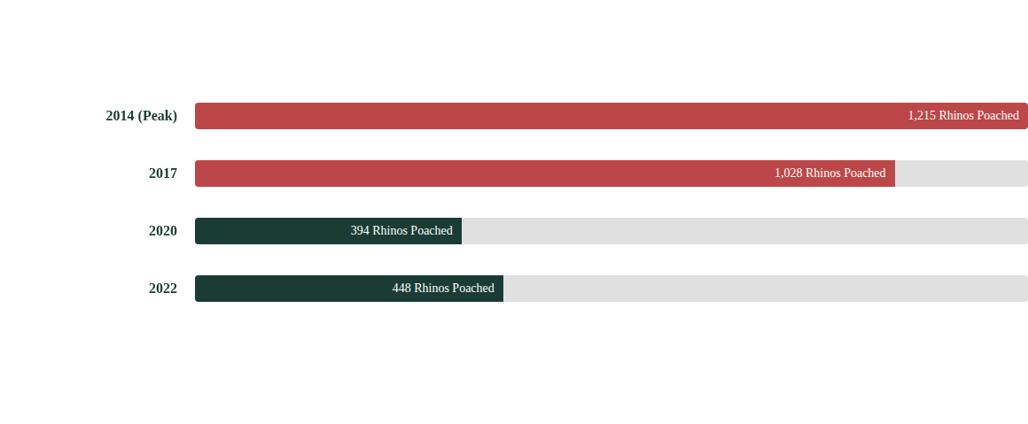
South African Rhino Poaching
While still a crisis, enhanced security has reduced poaching numbers from their 2014 peak.
The drop in 2020 was partly due to COVID-19 lockdowns, but numbers are slowly rising again, indicating the need for constant vigilance.

Slide 19
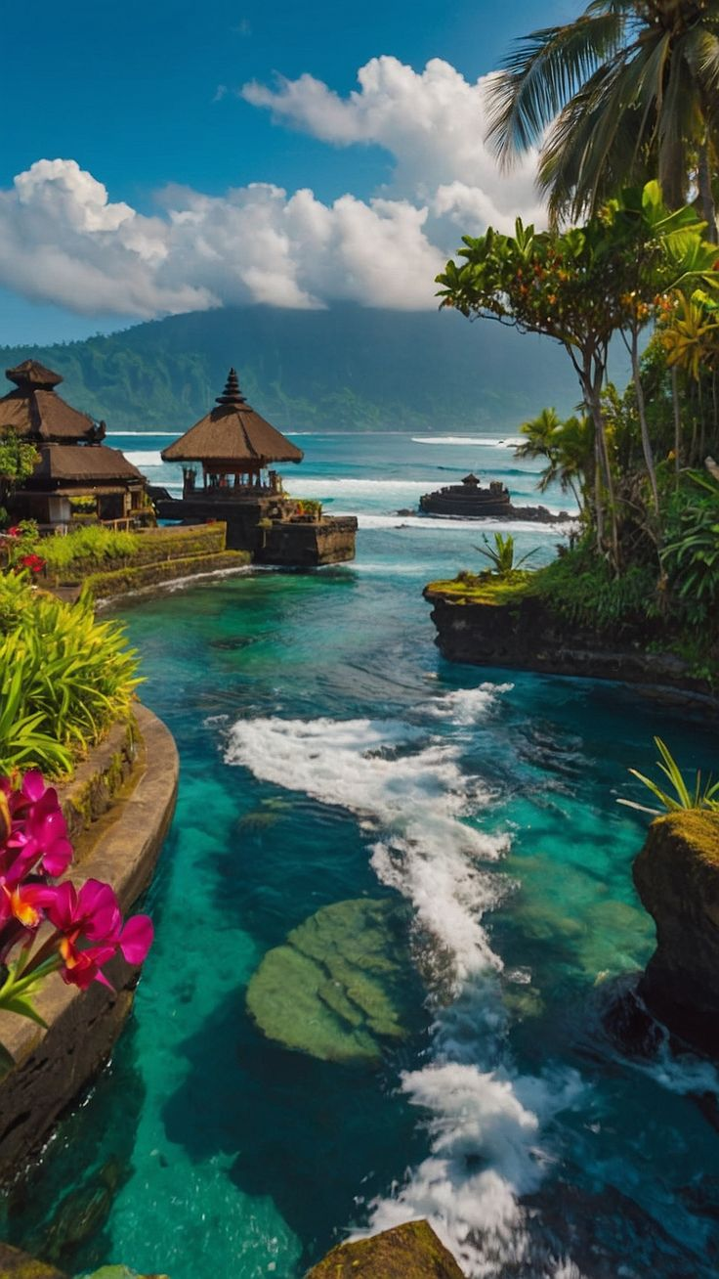
Marine Conservation
Marine Protected Areas (MPAs) are essential for replenishing fish stocks and protecting coral reefs.
The Great Barrier Reef and the Papahānaumokuākea Marine National Monument demonstrate how restricting fishing allows ecosystems to regenerate, spilling over benefits to adjacent areas.

Slide 20

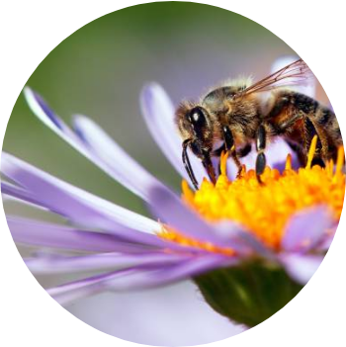
The Plight of Pollinators
Conservation isn't just about large mammals. Pollinators like bees, butterflies, and bats are critical for 75% of global food crops.
Threats: Pesticides, habitat loss, and monoculture farming.
Solution: Planting native wildflowers and reducing chemical use.

Slide 21
The Path Forward
Sustainable Future Goals

Slide 22

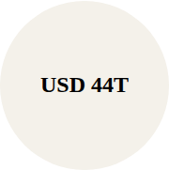
The Economics of Nature
Nature's GDP
The World Economic Forum estimates that over half the world's total GDP is moderately or highly dependent on nature and its services.
$44 Trillion: Economic value generation dependent on nature.
Risk: Economic loss if ecosystems collapse.

Slide 23
The 30x30 Initiative
A global goal to designate 30% of Earth's land and ocean area as protected areas by 2030.
2010
2022
2025
2030
Aichi Targets set (mostly missed).
COP15 adopts Kunming-Montreal Framework.
National strategies implemented.
Target: 30% Global Protection.

Slide 24



Emerging Challenges
Genetic Diversity
Political Will
Funding Gaps
Even if numbers rise, low genetic diversity can make species vulnerable to disease (e.g., Cheetahs).
Conservation often takes a backseat to short-term economic gain and industrial development.
Current global spending on biodiversity needs to triple to meet the 2030 targets.

Slide 25

Questions & Discussion
Thank you for your attention.

Slide 26

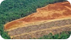

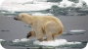
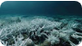
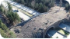
Image Sources
https://www.ausableriver.org/sites/default/files/styles/900x450/public/caring_-_forestry1.jpg?itok=LGwbDzDF
Source: www.ausableriver.org
https://earth.org/wp-content/uploads/2021/11/Untitled-design-88.jpg
Source: earth.org
https://i.ytimg.com/vi/ikVXqE7tozg/maxresdefault.jpg
Source: www.youtube.com
https://media.istockphoto.com/id/157393199/photo/polar-bear-on-dire-straits-over-small-piece-of-ice.jpg?s=612x612&w=0&k=20&c=W_2CM0cIhHMN3LQzEuKyJKBubvAUK3rahIP8evSRL8o=
Source: www.istockphoto.com
https://static.vecteezy.com/system/resources/thumbnails/048/426/662/small/bleaching-coral-reefs-and-the-disappearance-of-vibrant-sea-life-illustrating-the-marine-ecosystem-decline-caused-by-global-warming-generated-ai-photo.jpg
Source: www.vecteezy.com
https://img.hghlnd.com/imgix/https://detroitcatholic.nyc3.digitaloceanspaces.com/20240603T2126-WILDLIFE-CROSSINGS-CREATION-1777605.JPG?w=2400&h=1350&fit=crop&crop=faces
Source: www.detroitcatholic.com

Slide 27

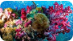
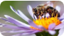


Image Sources
https://media.istockphoto.com/id/876323596/photo/tiger-in-snow.jpg?s=612x612&w=0&k=20&c=lxLUX8YEosFlbQQJTxAITUaUdexmbpTvytGWbanrh5A=
Source: www.istockphoto.com
https://discovery.sndimg.com/content/dam/images/discovery/fullset/2021/6/29/GettyImages-1189048716.jpg.rend.hgtvcom.1280.853.suffix/1624995019897.jpeg
Source: www.discovery.com
https://media.istockphoto.com/id/945905878/photo/bee-or-honeybee-in-latin-apis-mellifera-on-flower.jpg?s=612x612&w=0&k=20&c=N2TW9pv1LRFZU7ji1BezOxWozVpX7ucnWeQhTabBOLw=
Source: www.istockphoto.com
https://png.pngtree.com/png-vector/20240926/ourlarge/pngtree-photorealistic-elephant-majestic-african-savanna-animal-large-ivory-tusks-enormous-flapping-png-image_13917166.png
Source: pngtree.com
https://paveikslai.lt/172991-large_default/oleg-riabcuk-painting-last-kiss-of-the-evening.jpg
Source: paveikslai.lt

